Slide 1
Tutorial 11 FINAL EXAM PRACTICE

Slide 2
Final Exam
Date: Friday 11 December 2020
Time: 1:00pm, Sydney time (13:00)
Format: Online
Duration: 130 minutes (2 hours plus 10 minutes reading time)
You are also given additional time for accessing the exam and uploading your answers. You have 15 minutes buffer time to access the exam at the beginning, and 30 minutes of upload time at the end.

Slide 3
Format of the exam
Open book.
Four questions.
All questions are short answer, requiring written or mathematical responses.
You are required to upload your working and answers to all four questions.

Slide 4
What material is assessable?
All material from weeks 1 to 12
Material covered in the lectures and tutorials is assessable.

Slide 5
This semester
Week 1: Introduction and How to Think Like an Economist
Week 2: Game Theory – an intro to strategic decision making
Week 3: Market Structure – the context in which relationships occur
Week 4: Pricing – relationship between a firms and its customers
Week 5: Product differentiation – relationship between a firm and its rivals
Week 6: What is a firm?

Slide 6
This semester
Week 7: Organisational Architecture
Week 8: Midterm Exam
Week 9: Hiring & Retaining
Week 10: Incentivising Employees
Week 11: Performance Evaluation
Week 12: Vertical Boundaries of the Firm

Slide 7
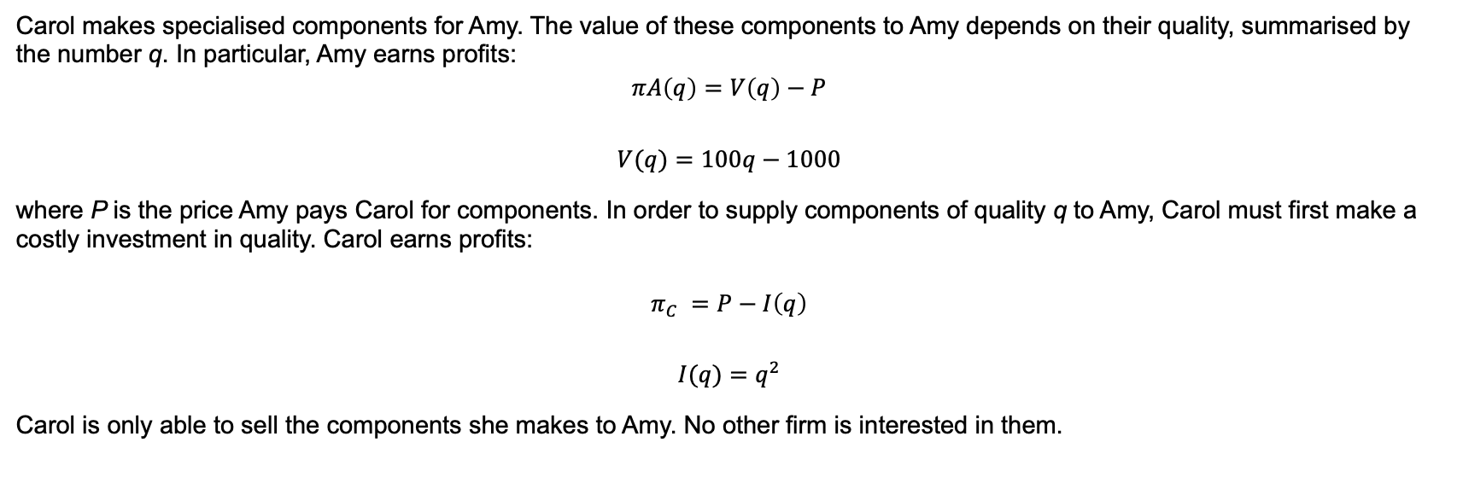
QUESTION 1
Carol makes specialised components for Amy. The value of these components to Amy depends on their quality, summarised by the number q. In particular, Amy earns profits:
$$πA\left(q\right)=V\left(q\right)−P$$
$$V(q)=100q−1000$$
where P is the price Amy pays Carol for components. In order to supply components of quality q to Amy, Carol must first make a costly investment in quality. Carol earns profits:
$$π_{C} =P−I\left(q\right)$$
$$I(q)=q^{2}$$
Carol is only able to sell the components she makes to Amy. No other firm is interested in them.

Slide 8
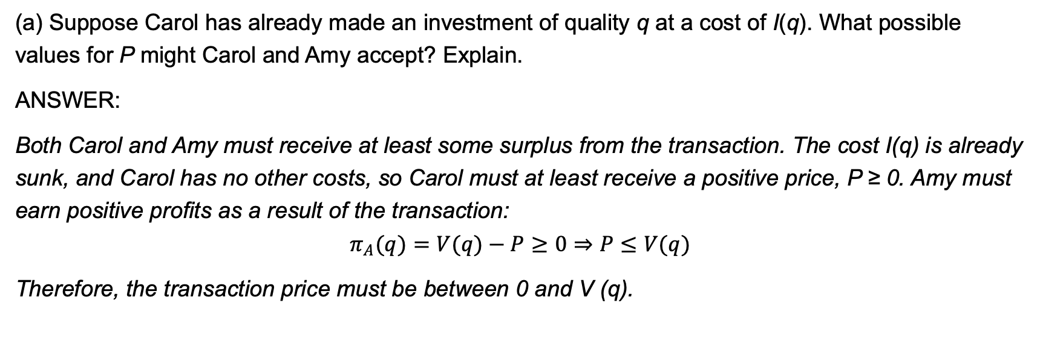
QUESTION 1
(a) Suppose Carol has already made an investment of quality q at a cost of I(q). What possible values for P might Carol and Amy accept? Explain.
ANSWER:
Both Carol and Amy must receive at least some surplus from the transaction. The cost I(q) is already sunk, and Carol has no other costs, so Carol must at least receive a positive price, P ≥ 0. Amy must earn positive profits as a result of the transaction:
$$π_{A}(q)=V(q)−P≥0⇒P≤V(q)$$
Therefore, the transaction price must be between 0 and V (q).

Slide 9
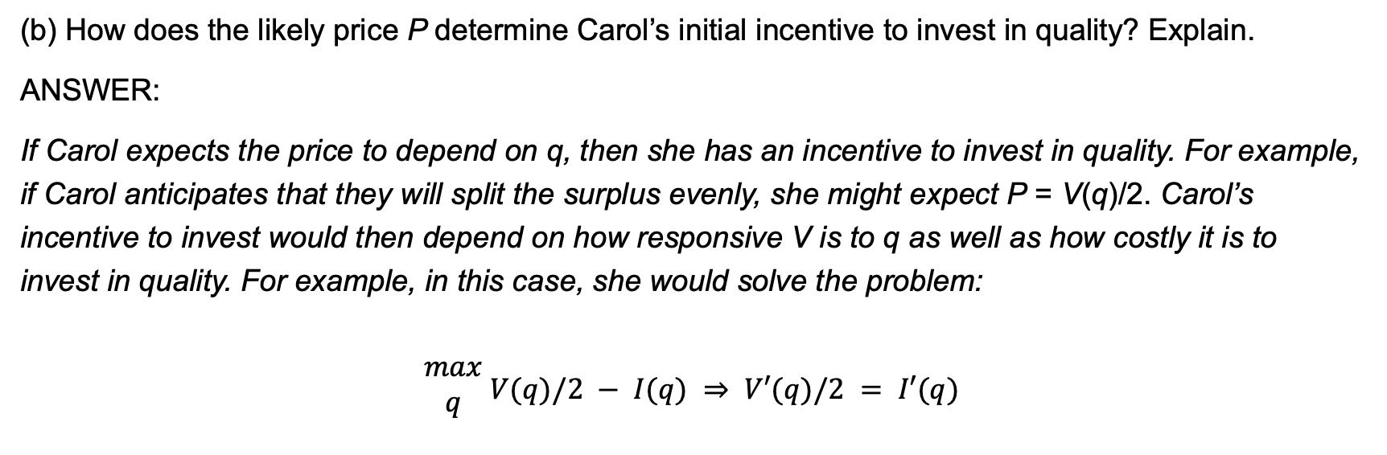
QUESTION 1
(b) How does the likely price P determine Carol’s initial incentive to invest in quality? Explain.
ANSWER:
If Carol expects the price to depend on q, then she has an incentive to invest in quality. For example, if Carol anticipates that they will split the surplus evenly, she might expect P = V(q)/2. Carol’s incentive to invest would then depend on how responsive V is to q as well as how costly it is to invest in quality. For example, in this case, she would solve the problem:
$$\begin{matrix}max \\ q\end{matrix} V(q)/2 − I(q) ⇒ V′(q)/2 = I′(q)$$

Slide 10
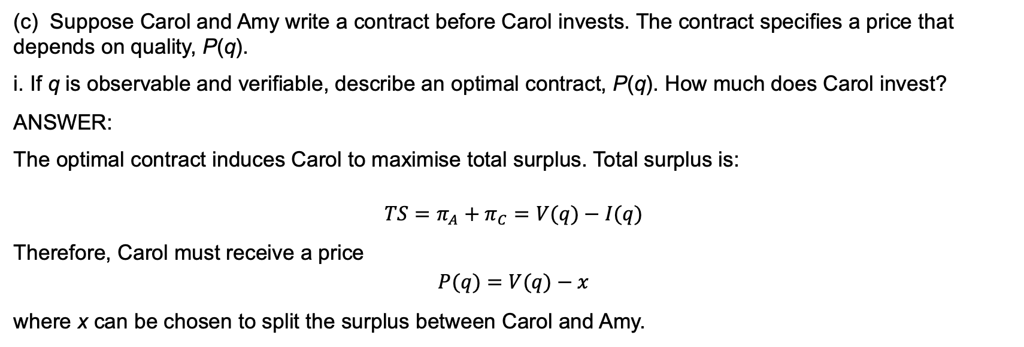
QUESTION 1
(c) Suppose Carol and Amy write a contract before Carol invests. The contract specifies a price that depends on quality, P(q).
i. If q is observable and verifiable, describe an optimal contract, P(q). How much does Carol invest?
ANSWER:
The optimal contract induces Carol to maximise total surplus. Total surplus is:
$$TS=π_{A}+π_{C}=V(q)−I(q)$$
Therefore, Carol must receive a price
$$P(q)=V(q)−x$$
where x can be chosen to split the surplus between Carol and Amy.

Slide 11
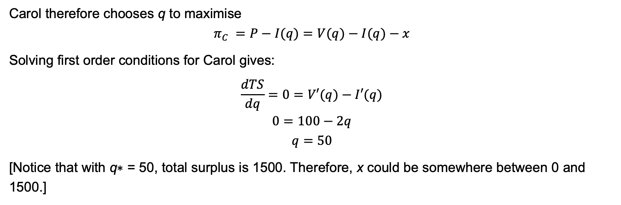
QUESTION 1
Carol therefore chooses q to maximise
$$π_{C} =P−I(q)=V(q)−I(q)−x$$
Solving first order conditions for Carol gives:
$$\frac{dTS}{dq}=0=V′(q)−I′(q)$$
$$0=100−2q$$
$$q=50$$
[Notice that with q∗ = 50, total surplus is 1500. Therefore, x could be somewhere between 0 and 1500.]

Slide 12
QUESTION 1
ii. Suppose q is imperfectly observable. How would this impact Carol’s incentive to invest?
Explain.
ANSWER:
If q is imperfectly observable, Carol anticipates that she may be under rewarded for her investment in quality. This gives her a reduced incentive to invest in quality. Even if Carol negotiates a contract with Amy in which she is paid for quality, she knows that she is unable to perfectly verify her quality. This will give Amy the chance to behave opportunistically by under compensating Carol for her investment. That is, the hold-up problem still applies.

Slide 13
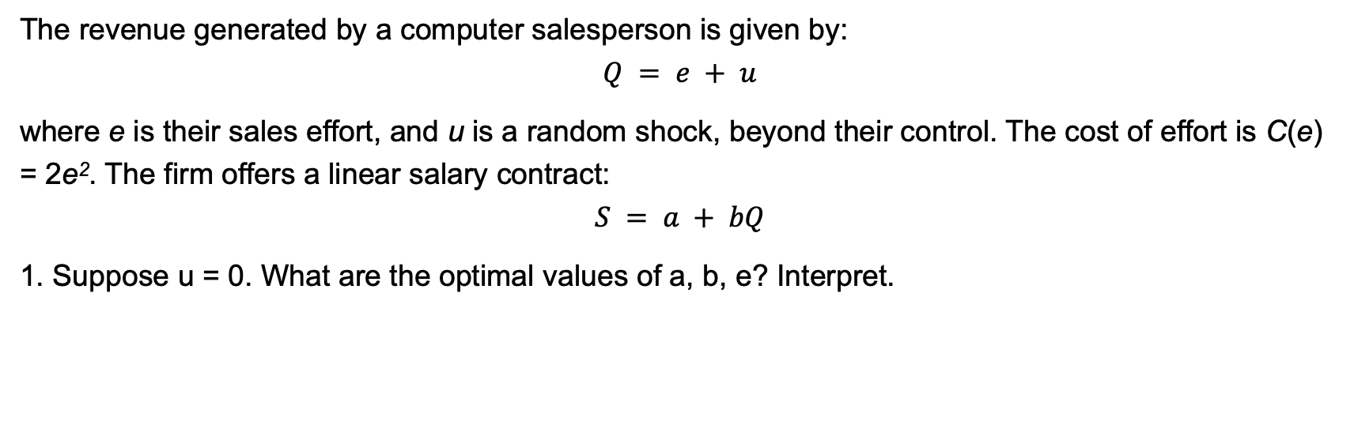
QUESTION 2
The revenue generated by a computer salesperson is given by:
$$Q = e + u$$
where e is their sales effort, and u is a random shock, beyond their control. The cost of effort is C(e) = 2e². The firm offers a linear salary contract:
$$S = a + bQ$$
1. Suppose u = 0. What are the optimal values of a, b, e? Interpret.

Slide 14
QUESTION 2
Implicitly, the timing of the game is as follows:
1. The firm chooses the salary contract. 2. The worker chooses effort.
Therefore, we will solve the problem by backward induction.
First, work out optimal effort for the worker, given the salary contract.
Second, work out the optimal contract, given the reaction function of the worker.

Slide 15
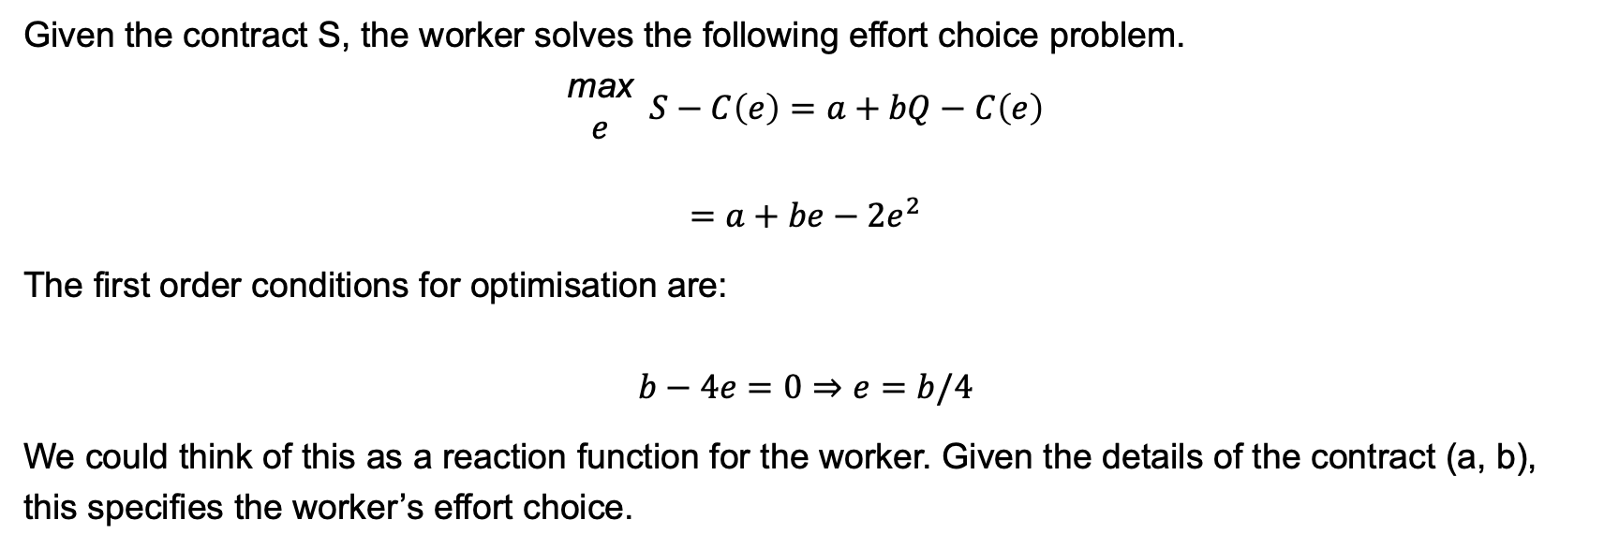
QUESTION 2
Given the contract S, the worker solves the following effort choice problem.
$$\begin{matrix}\text{max} \\ e\end{matrix} S−C\left(e\right)=a+bQ−C\left(e\right)$$
$$=a+be−2e^{2}$$
The first order conditions for optimisation are:
$$b−4e=0⇒e=b/4$$
We could think of this as a reaction function for the worker. Given the details of the contract (a, b), this specifies the worker’s effort choice.

Slide 16
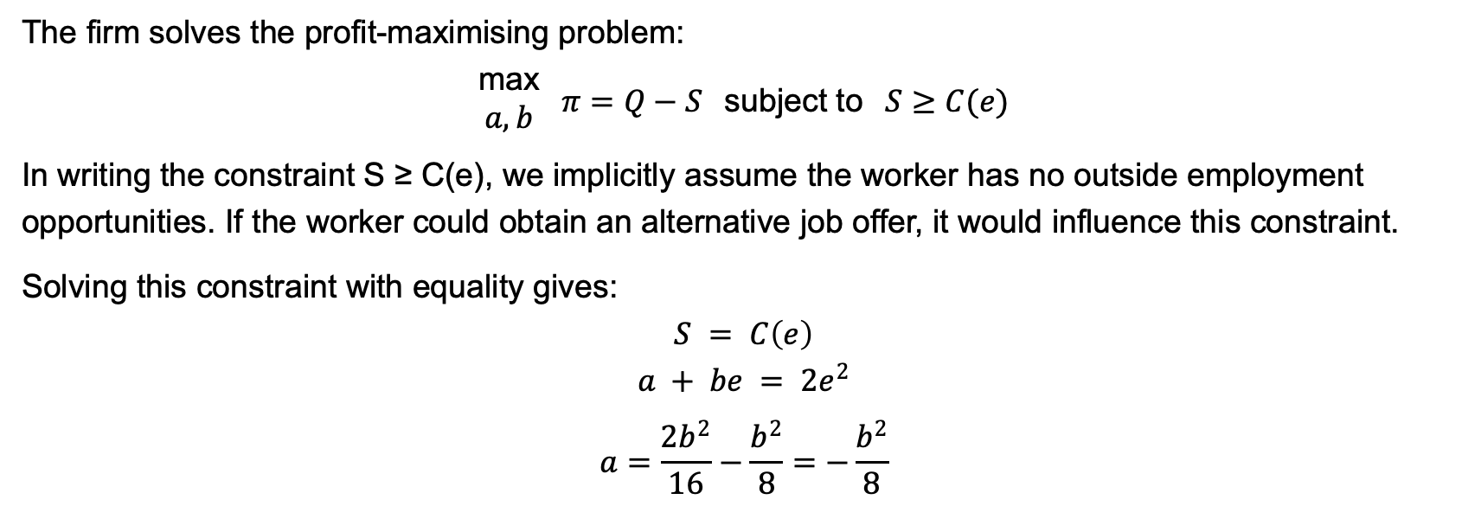
QUESTION 2
The firm solves the profit-maximising problem:
$$\begin{matrix}\text{max} \\ a,b\end{matrix} π=Q−S \text{subject} \text{to} S≥C(e)$$
In writing the constraint S ≥ C(e), we implicitly assume the worker has no outside employment opportunities. If the worker could obtain an alternative job offer, it would influence this constraint.
Solving this constraint with equality gives:
$$S = C\left(e\right)$$
$$a + be = 2e^{2}$$
$$a=\frac{2b^{2}}{16}−\frac{b^{2}}{8}=−\frac{b^{2}}{8}$$

Slide 17
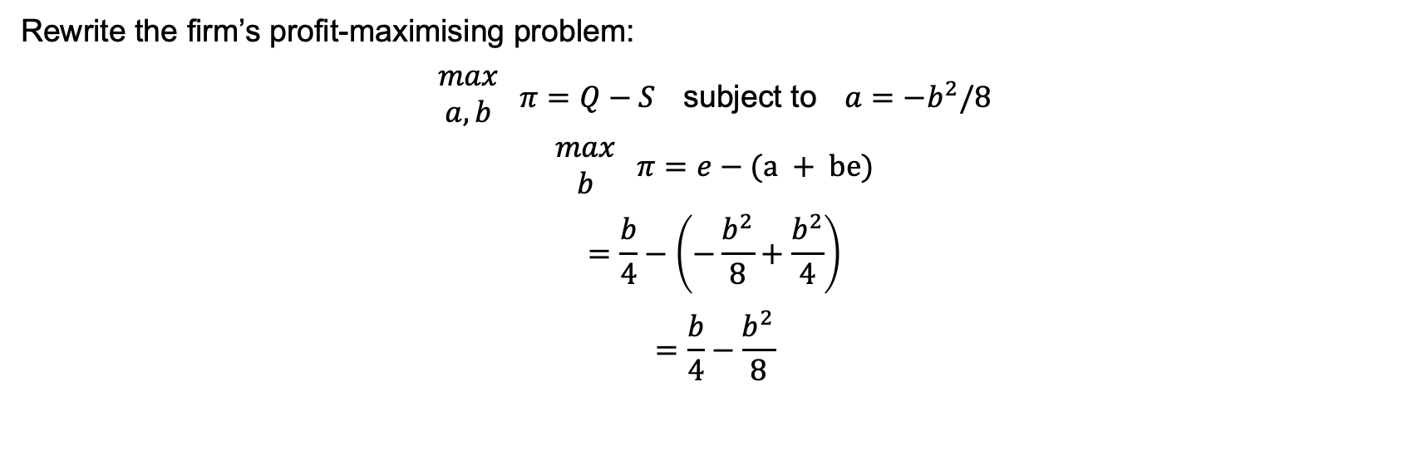
QUESTION 2
Rewrite the firm’s profit-maximising problem:
$$\begin{matrix}max \\ a,b\end{matrix} π=Q−S \text{subject} \text{to} a=−b^{2}/8$$
$$\begin{matrix}max \\ b\end{matrix} π=e−(a + be)$$
$$=\frac{b}{4}−\left(−\frac{b^{2}}{8}+\frac{b^{2}}{4}\right)$$
$$=\frac{b}{4}−\frac{b^{2}}{8}$$

Slide 18
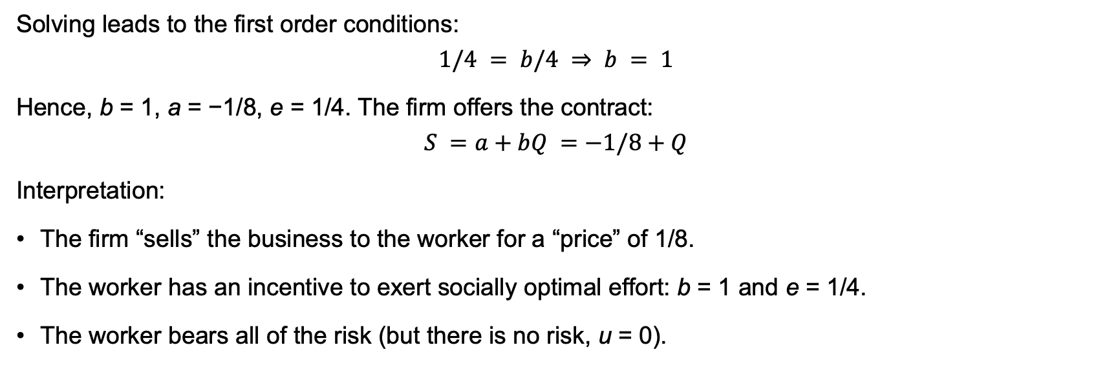
QUESTION 2
Solving leads to the first order conditions:
$$1/4 = b/4 ⇒ b = 1$$
Hence, b = 1, a = −1/8, e = 1/4. The firm offers the contract:
$$S =a+bQ =−1/8+Q$$
Interpretation:
The firm “sells” the business to the worker for a “price” of 1/8.
The worker has an incentive to exert socially optimal effort: b = 1 and e = 1/4.
The worker bears all of the risk (but there is no risk, u = 0).

Slide 19
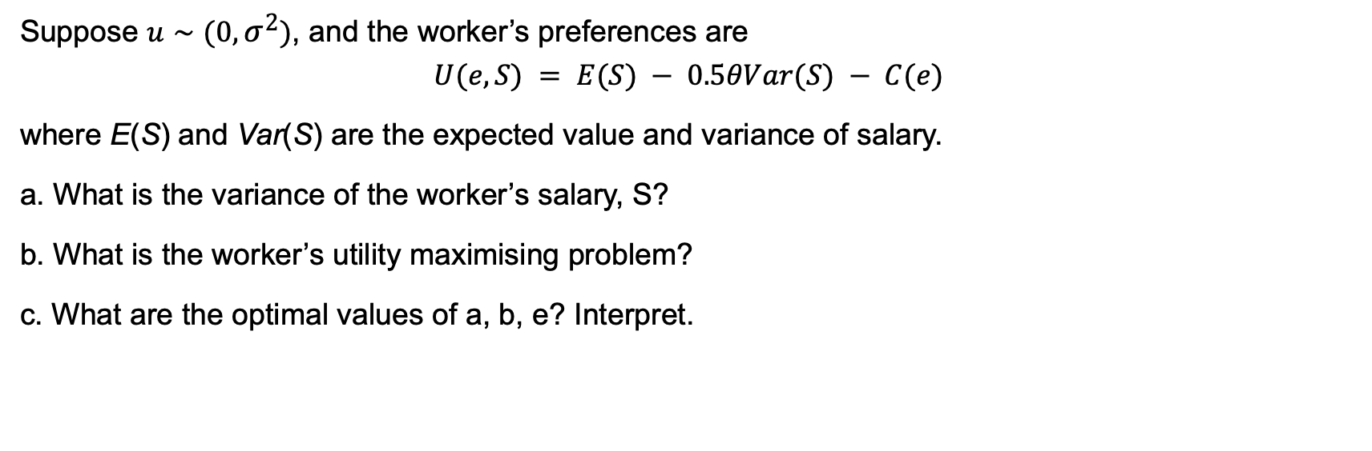
QUESTION 2
Suppose $u∼(0,σ^{2})$, and the worker’s preferences are
$$U(e,S) = E(S) − 0.5θVar(S) − C(e)$$
where E(S) and Var(S) are the expected value and variance of salary.
a. What is the variance of the worker’s salary, S?
b. What is the worker’s utility maximising problem?
c. What are the optimal values of a, b, e? Interpret.

Slide 20
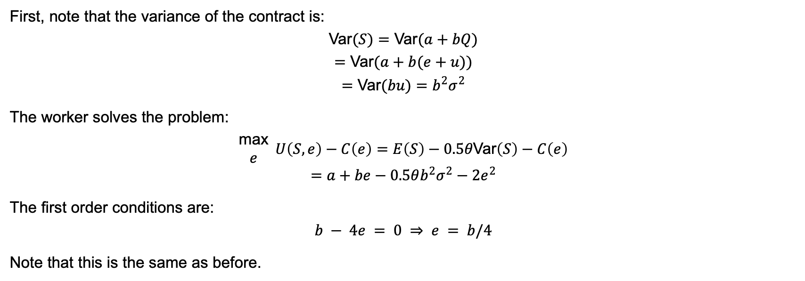
QUESTION 2
First, note that the variance of the contract is:
$$\text{Var}(S)=\text{Var}(a+bQ)$$
$$=\text{Var}(a+b(e+u))$$
$$=\text{Var}(bu)=b^{2}σ^{2}$$
The worker solves the problem:
$$\begin{matrix}\text{max} \\ e\end{matrix} U\left(S,e\right)−C\left(e\right)=E\left(S\right)−0.5θ\text{Var}\left(S\right)−C\left(e\right)$$
$$=a+be−0.5θb^{2}σ^{2}−2e^{2}$$
The first order conditions are:
$$b − 4e = 0 ⇒ e = b/4$$
Note that this is the same as before.

Slide 21
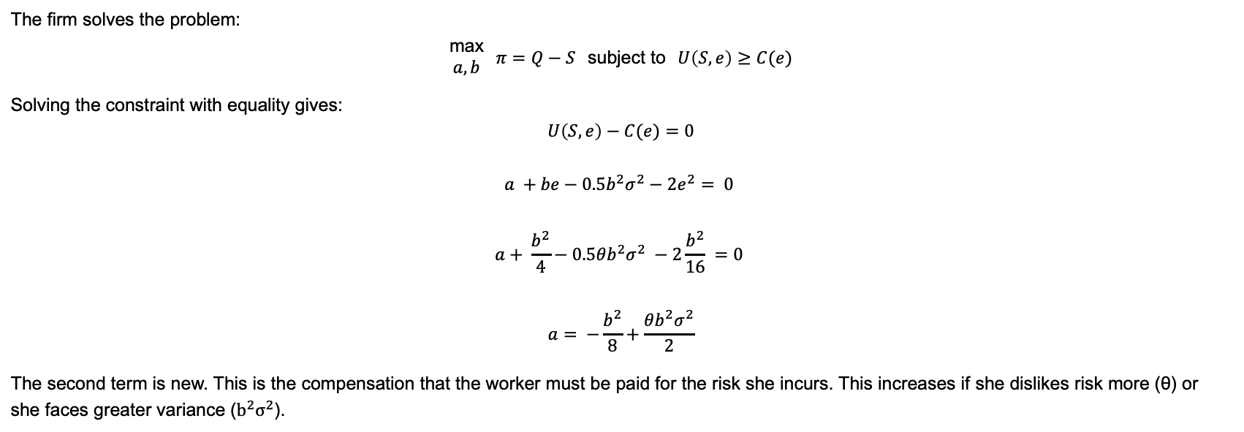
QUESTION 2
The firm solves the problem:
$$\begin{matrix}\text{max} \\ a,b\end{matrix} π=Q−S \text{subject} \text{to} U\left(S,e\right)≥C(e)$$
Solving the constraint with equality gives:
$$U\left(S,e\right)−C(e)=0$$
$$a +be−0.5b^{2}σ^{2}−2e^{2}= 0$$
$$a+ \frac{b^{2}}{4}−0.5θb^{2}σ^{2} −2\frac{b^{2}}{16} =0$$
$$a= −\frac{b^{2}}{8}+\frac{θb^{2}σ^{2}}{2}$$
The second term is new. This is the compensation that the worker must be paid for the risk she incurs. This increases if she dislikes risk more (θ) or she faces greater variance ($b^{2}σ^{2}$).

Slide 22

QUESTION 2
Rewrite the firm’s profit-maximising problem:
$$\begin{matrix}\text{max} \\ a,b\end{matrix} π=Q−S \text{subject} \text{to} a= −\frac{b^{2}}{8}+\frac{θb^{2}σ^{2}}{2}$$
$$\begin{matrix}\text{max} \\ b\end{matrix} π=e−\left(a+be\right)$$
$$=\frac{b}{4}−\left(−\frac{b^{2}}{8}+\frac{θb^{2}σ^{2}}{2}+\frac{b^{2}}{4}\right)$$
$$=\frac{b}{4}−\frac{b^{2}}{8}−\frac{θb^{2}σ^{2}}{2}$$
Solving leads to the first order conditions:
$$\frac{1}{4}−\frac{b}{4}− θσ^{2}b= 0$$
$$b\left(1+4θσ^{2}\right)=1$$
$$b=\frac{1}{1+4θσ^{2}}$$

Slide 23
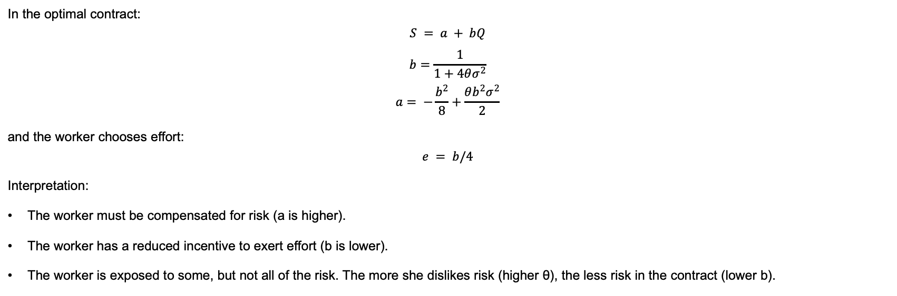
QUESTION 2
In the optimal contract:
$$S = a + bQ$$
$$b=\frac{1}{1+4θσ^{2}}$$
$$a= −\frac{b^{2}}{8}+\frac{θb^{2}σ^{2}}{2}$$
and the worker chooses effort:
$$e = b/4$$
Interpretation:
The worker must be compensated for risk (a is higher).
The worker has a reduced incentive to exert effort (b is lower).
The worker is exposed to some, but not all of the risk. The more she dislikes risk (higher θ), the less risk in the contract (lower b).

